Slide 1
SIC030 - PPT - SESI ke 4 Sistem Perdagangan Elektronik
Mekanisme, Platform dan Alat Perdagangan Elektronik
M HANIF JUSUF ST MKOM

Slide 2
Learning Objectives
Define e-marketplaces and list their components.
List the major types of electronic markets and describe their features.
Describe the types of intermediaries in EC and their roles.
Describe electronic catalogs, shopping carts, and search engines.

Slide 3
Learning Objectives
Describe the various types of auctions and list their characteristics.
Discuss the benefits, limitations, and impacts of auctions.
Describe bartering and negotiating online.
Define m-commerce and explain its role as a market mechanism.

Slide 4
Learning Objectives (cont.)
Discuss liquidity, quality, and success factors in e-marketplaces.
Describe the economic impact of EC.
Discuss competition in the digital economy.
Describe the impact of e-marketplaces on organizations.

Slide 5
How Raffles Hotel Is Conducting EC
The Problem
Very competitive industry
Owns and manages luxury and business hotels worldwide
Spends lavishly on every facet of its operation
Success depends on the company’s ability to lure customers to its hotels and facilities and on its ability to contain costs

Slide 6
How Raffles Hotel Is Conducting EC (cont.)
The Solution
Address two types of issues
Business-to-consumer
maintains a diversified corporate portal (raffles.com), open to the public
introduces customers to the company and its services
information on the hotels
a reservation system
links to travelers’ resources
CRM program
an online store for Raffles products

Slide 7
How Raffles Hotel Is Conducting EC (cont.)
The Results
Corporate portal helps in customer acquisition
Promotions and direct sales enable the hotel to maintain a relatively high occupancy
Private marketplace forces suppliers to disclose their prices and increases competition among suppliers
Company is saving about $1 million a year on procurement
Company is expanding aggressively in the Asian markets

Slide 8
How Raffles Hotel Is Conducting EC (cont.)
What we can learn…
Old-economy hotel transformed itself into a click-and-mortar business by creating two separate electronic markets:

Slide 9
How Raffles Hotel Is Conducting EC (cont.)
B2C market—selling its services to consumers
B2B private market—to buy from its suppliers and to sell products to other hotels
Used several e-commerce mechanisms:
corporate portal
electronic catalogs
e-procurement using reverse auctions

Slide 10
Electronic Marketplaces
Markets play a central role in the economy facilitating the exchange of:
information
goods
services
payments
Markets create economic value for:
buyers
sellers
market intermediaries
society at large

Slide 11
Electronic Marketplaces (cont.)
Three main functions of markets
matching buyers and sellers
facilitating the exchange of information, goods, services, and payments associated with market transactions
providing an institutional infrastructure, such as a legal and regulatory framework, that enables the efficient functioning of the market

Slide 12
Electronic Marketplaces (cont.)
In recent years markets have seen a dramatic increase in the use of IT—EC has:
increased market efficiencies by expediting or improving functions
been able to significantly decrease the cost of executing these functions

Slide 13
Marketspace
Marketspace: A marketplace in which sellers and buyers exchange goods and services for money (or for other goods and services), but do so electronically

Slide 14
Marketspace Components
Customers
Sellers
Products
Infrastructure
Front end
Back end
Intermediaries
Other business partners
Support services

Slide 15
Marketspace Components (cont.)
Digital products: Goods that can be transformed to digital format and delivered over the Internet
Front end: The portion of an
e-seller’s business processes through which customers interact, including the seller’s portal, electronic catalogs, a shopping cart, a search engine, and a payment gateway

Slide 16
Marketspace Components (cont.)
Back end: The activities that support online order-taking. It includes fulfillment, inventory management, purchasing from suppliers, payment processing, packaging, and delivery
Intermediary: A third party that operates between sellers and buyers

Slide 17

Types of Electronic Markets
Electronic storefront: A single or company Web site where products and services are sold
Mechanisms necessary for conducting the sale:
electronic catalogs
search engine
e-auction facilities
payment gateway
shipment court
customer services

Slide 18
Types of Electronic Markets (cont.)
e-mall (online mall): An online shopping center where many stores are located
some are merely directories
some provide shared services (e.g., choicemall.com).
some are actually large click-and-mortar retailers
some are virtual retailers (e.g., buy.com)

Slide 19
Types of Electronic Markets (cont.)
Types of stores and malls
General stores/malls
Specialized stores/malls
Regional versus global stores
Pure online organizations versus click-and-mortar stores

Slide 20
Types of Electronic Markets (cont.)
e-marketplace:
An online market, usually B2B, in which buyers and sellers exchange goods or services; the three types of e-marketplaces are private, public, and consortia
Private e-marketplaces:
Online markets owned by a single company; can be either sell-side or buyside marketplaces
Sell-side e-marketplace:
A private e-market in which a company sells either standard or customized products to qualified companies

Slide 21
Types of Electronic Markets (cont.)
Buy-side e-marketplace:
A private e-market in which a company makes purchases from invited suppliers
Public e-marketplaces:
B2B markets, usually owned and/or managed by an independent third party, that include many sellers and many buyers; also known as exchanges
Consortia:
E-marketplaces owned by a small group of large vendors, usually in a single industry

Slide 22
Information Portals
Information portal: a single point of access through a Web browser to business information inside and/or outside an organization

Slide 23
Information Portals (cont.)
Six types of portals
Commercial (public) portals
Corporate portals
Publishing portals
Personal portals
Mobile portals: a portal accessible via a mobile device
Voice portals: a portal accessed by telephone or cell phone

Slide 24
Intermediation and Syndication in E-Commerce
Intermediaries (brokers) provide value-added activities and services to buyers and sellers
Intermediaries in the physical world are wholesalers and retailers
Infomediaries:
electronic intermediaries that control information flow in cyberspace, often aggregating information and selling it to others

Slide 25
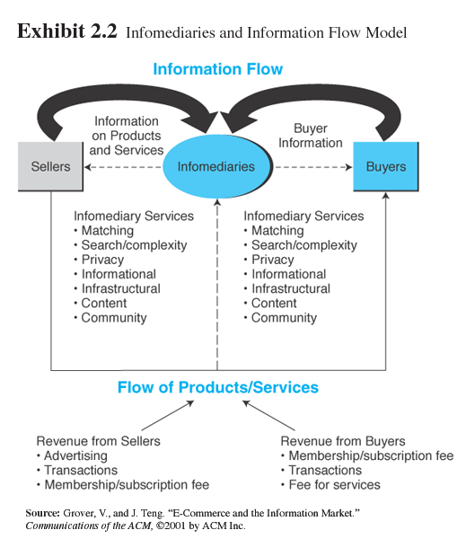
Exhibit 2.2 Infomediaries and Information Flow Model

Slide 26

Intermediation and Syndication in E-Commerce (cont.)
Roles and value of intermediaries in
e-markets
Search costs
Lack of privacy
Incomplete information
Contract risk
Pricing inefficiencies

Slide 27
Intermediation and Syndication in E-Commerce (cont.)
E-distributors in B2B
e-distributor:
An e-commerce intermediary that connects manufacturers (suppliers) with buyers by aggregating the catalogs of many suppliers in one place—the intermediary’s Web site
Maintenance, repair, and operation items (MROs):
Routine items that are usually not under regular contract with suppliers

Slide 28
Intermediation and Syndication in E-Commerce (cont.)
Disintermediation and reintermediation
Disintermediation:
Elimination of intermediaries between sellers and buyers
Reintermediation:
Establishment of new intermediary roles for traditional intermediaries that were disintermediated

Slide 29
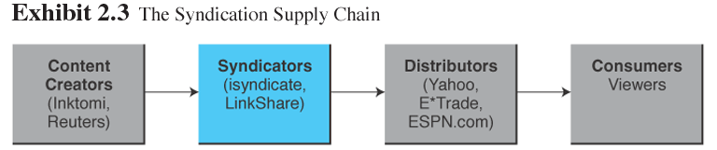
Intermediation and Syndication in E-Commerce (cont.)
Syndication as an EC mechanism
Syndication:
The sale of the same good (e.g., digital content) to many customers, who then integrate it with other offerings and resell it or give it away free

Slide 30
Diamonds Forever—Online
The age-old business of gem buying is very inefficient: Several layers of intermediaries can jack up the price of a gem 1,000% between wholesale and final retail prices

Slide 31
Diamonds Forever—Online (cont.)
American Don Kogen made his fortune in Chanthaburi (Thailand)—one of the world’s leading centers for processing gems
He started by purchasing low-grade gems from sellers that arrived early in the morning and then selling them for a small profit to dealers who arrived late in the day
This quick turnover of inventory helped him build up his capital resources
He reached the U.S. gem market using advertising

Slide 32
Diamonds Forever—Online (cont.)
Using faxes, he shortened the order time
In 1998, Kogen decided to use the Internet—establishing thaigem.com and sold his first gem online
By 2001, the revenue from his online business reached $4.3 million, and it more than doubled (to $9.8 million) in 2002
Online sales account for 85 percent of the revenue
The buyers are mostly dealers or retailers such as Wal-Mart or QVC

Slide 33
Diamonds Forever—Online (cont.)
He buys raw or refined gems from all over the world, some online, catering to the demand of his customers
Thaigem’s competitive edge is low prices
The proximity to gem processing factories and the low labor cost enable prices significantly lower than his online competitors

Slide 34
Diamonds Forever—Online (cont.)
Unsatisfied customers can return merchandise within 30 days, no questions asked
Delivery to any place in the world is made via Federal Express, at about $15 per shipment

Slide 35
Electronic Catalogs
Electronic catalogs:
The presentation of product information in an electronic form; the backbone of most e-selling sites
Electronic catalogs can be classified by the following dimensions:
The dynamics of the information presentation
The degree of customization
Integration with business processes

Slide 36
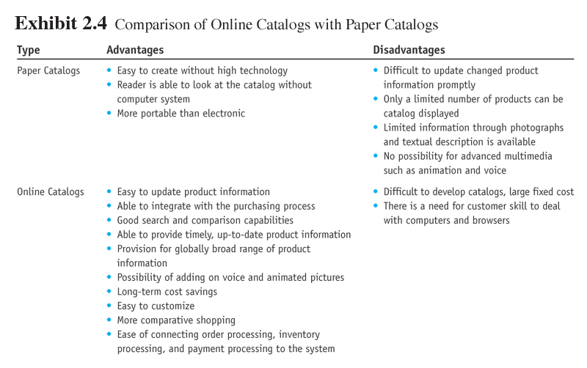
Exhibit 2.4 Comparison of Online Catalogs with Paper Catalogs

Slide 37
Electronic Catalogs (cont.)
Customized catalogs
A catalog assembled specifically for a company, usually a customer of the catalog owner

Slide 38
Electronic Catalogs (cont.)
Two approaches to customized catalogs
Let the customers identify the interesting parts out of the total catalog
Let the system automatically identify the characteristics of customers based on their transaction records

Slide 39
Electronic Catalogs (cont.)
Search engine
A computer program that can access a database of Internet resources, search for specific information or keywords, and report the results
Software (intelligent) agent:
Software that can perform routine tasks that require intelligence
Electronic shopping cart:
An order-processing technology that allows customers to accumulate items they wish to buy while they continue to shop

Slide 40
Electronic Catalogs at Boise Cascade
Boise Cascade Office Products
$4-billion office products wholesaler customer base includes over 100,000 large corporate customers and 1 million small ones
900-page paper catalog used to be mailed to customers once each year
Boise also sent mini-catalogs tailored to customers’ individual needs based on past buying habits and purchase patterns

Slide 41
Electronic Catalogs at Boise Cascade (cont.)
In 1996, the company placed its catalogs online
Customers view the catalog at boiseoffice.com and can order straight from the site or submit orders by e-mail
The orders are shipped the next day
Customers are then billed
In 1997, the company generated 20 percent of its sales through the Web site

Slide 42
Electronic Catalogs at Boise Cascade (cont.)
Boise expects the Internet business to generate 80 percent of its total sales by 2020
Boise prepares thousands of individualized catalogs for its customers
paper customer catalog, primarily because As of 2002, the company has been sending paper catalogs only when specifically requested
It used to take about 6 weeks to produce a single of the time involved in pulling together all the data

Slide 43
Electronic Catalogs at Boise Cascade (cont.)
Now the process of producing a Web catalog that is searchable, rich in content, and available in a variety of formats takes only 1 week
One major advantage of customized catalogs is pricing
Boise estimates that electronic orders cost approximately 55 percent less to process than paper-based orders

Slide 44
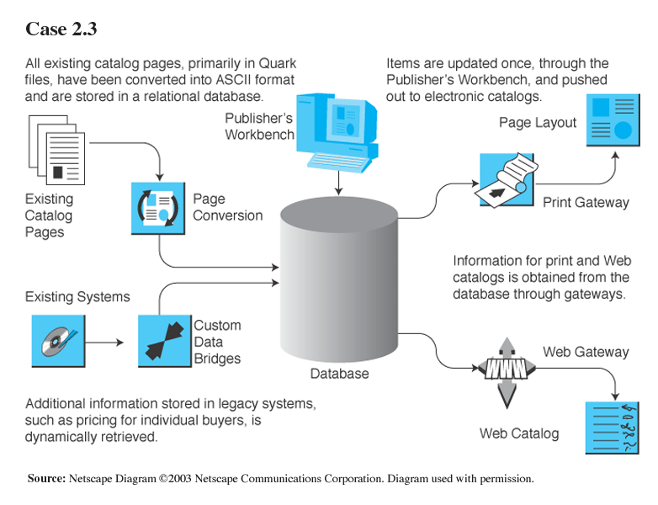
Electronic Catalogs at Boise Cascade (cont.)

Slide 45
Auctions as EC Market Mechanisms
Auction:
A market mechanism by which a seller places an offer to sell a product and buyers make bids sequentially and competitively until a final price is reached
Auctions can be done:
online
off-line
at public sites (eBay)
at private sites (by invitation)

Slide 46
Auctions as EC Market Mechanisms (cont.)
Electronic auctions (e-auctions):
Auctions conducted online
Host sites on the Internet serve as brokers, offering services for sellers to post their goods for sale and allowing buyers to bid on those items
Conventional business practices that traditionally have relied on contracts and fixed prices are increasingly being converted into auctions with bidding for online procurements

Slide 47
Auctions as EC Market Mechanisms (cont.)
Dynamic pricing:
Prices that change based on supply and demand relationships at any given time
At what price would you
buy/sell today?

Slide 48
Auctions as EC Market Mechanisms (cont.)
Four major categories of dynamic pricing
One buyer, one seller
One seller, many potential buyers
One buyer, many potential sellers
Many sellers, many buyers

Slide 49
Auctions as EC Market Mechanisms (cont.)
One buyer, one seller
Forward auction: An auction in which a seller entertains bids from buyers
One seller, many potential buyers
Forward auctions used for fast liquidation and as a selling channel. Price is increasing; the highest bidder wins

Slide 50
Auctions as EC Market Mechanisms (cont.)
One buyer, many potential suppliers
Reverse auction (bidding or tendering system):
Auction in which the buyer places an item for bid (tender) on a request for quote (RFQ) system, potential suppliers bid on the job, with price reducing sequentially, and the lowest bid wins; primarily a B2B or G2B mechanism

Slide 51
Auctions as EC Market Mechanisms (cont.)
One buyer, many potential sellers (special model)
“name-your-own-price” model:
Auction model in which a would-be buyer specifies the price (and other terms) they are willing to pay to any willing and able seller. It is a C2B model, pioneered by Priceline.com

Slide 52
Auctions as EC Market Mechanisms (cont.)
Many sellers, many buyers
Double auction:
Auctions in which multiple buyers and their bidding prices are matched with multiple sellers and their asking prices, considering the quantities on both sides

Slide 53
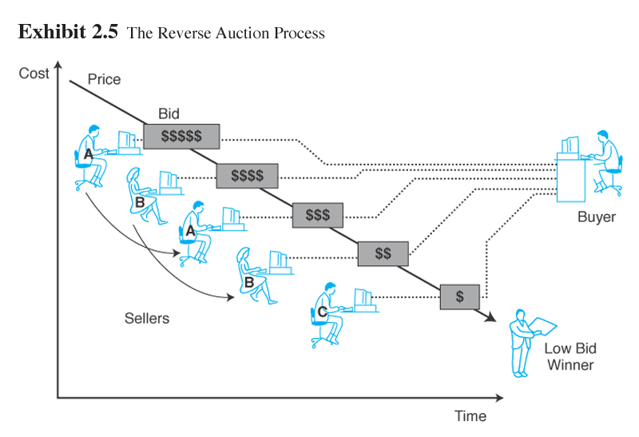
Exhibit 2.5 The Reverse Auction Process

Slide 54
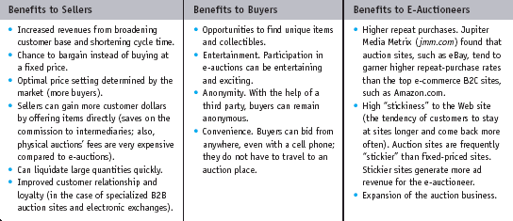
Benefits of E-Auctions

Slide 55
Limitations of E-Auctions (cont.)
Limitations of e-auctions
Lack of security
Possibility of fraud
Limited participation
Impacts of auctions
Auctions as a coordination mechanism
Auctions as a highly visible distribution mechanism.
Auctions as a component in e-commerce

Slide 56
Reverse Mortgage Auctions in Singapore
Homebuyers in Singapore, find the lowest mortgage rates at Dollardex (dollarDEX.com)
Reverse auctions are combined with “group purchasing” saving:
$20,000 over the life of a mortgage for each homeowner
$1,200 in waived legal fees

Slide 57
Reverse Mortgage Auctions in Singapore (cont.)
Dollardex’s first project:
The site invited potential buyers in three residential properties in Singapore to join the service
Applications, including financial credentials, were made on a secure Web site
Seven lending banks were invited to bid on the loans

Slide 58
Reverse Mortgage Auctions in Singapore (cont.)
In a secure “electronic room,” borrowers and lenders negotiated final terms
After 2 days of negotiations of interest rates and special conditions, the borrowers voted on one bank
18 borrowers on the United Overseas Bank (UOB), paying about 0.5 percent less than the regular mortgage interest rate as well as the waiver of the legal fees

Slide 59
Reverse Mortgage Auctions in Singapore (cont.)
UOB generated $10 million of business
Dollardex allows customers to participate in an individual reverse auction if they do not want to join a group
Flexibility is high; in addition to interest rates, banks are willing to negotiate down payment size and the option of switching from a fixed-rate to variable-rate loan

Slide 60
Reverse Mortgage Auctions in Singapore (cont.)
On average, there are 2.6 bank bids per customer
As of summer 2003 Dollardex.com also offers car loans, insurance policies, and travel services
Allows comparisons of mutual funds that have agreed to give lower front-end fees

Slide 61
Reverse Mortgage Auctions in Singapore (cont.)
Provides unit trusts in which you want to invest
Sets up a gift registry page for your wedding and invite your givers to place funds in them
Reports and advice are also available online as well as face-to-face

Slide 62
Bartering Online
Bartering:
An exchange of goods and services
e-bartering:
Bartering conducted online, usually by a bartering exchange
Bartering exchange:
A marketplace in which an intermediary arranges barter transactions

Slide 63
Negotiating Online
Negotiated pricing used for expensive or specialized products
Negotiated prices are popular when large quantities are purchased
Result from interactions and bargaining among sellers and buyers

Slide 64
Negotiating Online (cont.)
Deals with nonpricing terms, such as payment method and credit
Digital products and services can be personalized and “bundled” at a negotiated standard price

Slide 65
E-Commerce in the Wireless Environment: M-Commerce
Mobile computing:
Permits real-time access to information, applications, and tools that, until recently, were accessible only from a desktop computer
Mobile commerce (m-commerce):
E-commerce conducted via wireless devices
m-business:
The broadest definition of m-commerce, in which e-business is conducted in a wireless environment

Slide 66
E-Commerce in the Wireless Environment: M-Commerce (cont.)
Promise of m-commerce
Mobility significantly changes the manner in which people and trading partners interact, communicate, and collaborate
Mobile applications are expected to change the way we live, play, and do business
Much of the Internet culture may change to one based on mobile devices
M-commerce creates new business models for EC, notably location-based applications

Slide 67
E-Commerce in the Wireless Environment: M-Commerce (cont.)
DoCoMo’s (nttdocomo.com) i-Mode—pioneering wireless service—with a few clicks on a handset, i-Mode users can conduct a large variety of m-commerce activities
Shopping guides
Maps and transportation
Ticketing
News and reports
Personalized movie service
Entertainment
Dining and reservations
Additional services

Slide 68
Issues in E-Markets: Liquidity, Quality, and Success Factors
Early liquidity:
Achieving a critical mass of buyers and sellers as fast as possible, before a start-up company’s cash disappears
Quality uncertainty:
The uncertainty of online buyers about the quality of non-commodity type products that they have never seen, especially from an unknown vendor
Microproduct:
A small digital product costing a few cents

Slide 69
E-Market Success Factors
Product Characteristics
Digitizable products can be electronically distributed to customers, resulting in very low distribution costs, allowing order-fulfillment cycle time “to be minimal”
Industry Characteristics
Electronic markets are most useful when they are able to directly match buyers and sellers

Slide 70
E-Market Success Factors (cont.)
Seller Characteristics
Electronic markets reduce search costs, allowing consumers to find sellers offering lower prices
Consumer Characteristics
e-markets require a certain degree of effort on the part of the consumer, e-markets are more conducive to consumers who do some comparison and analysis before buying

Slide 71
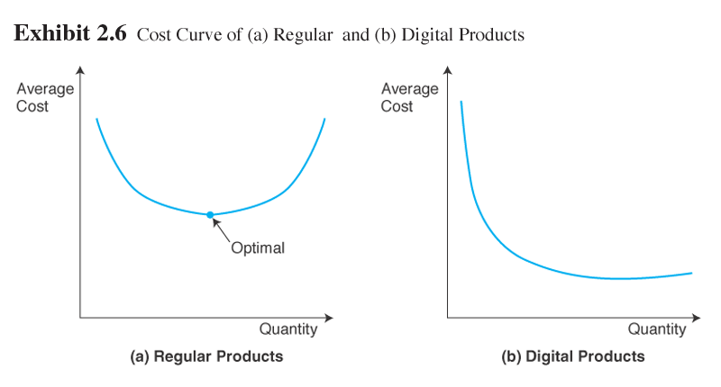
Economics of E-Marketplaces

Slide 72
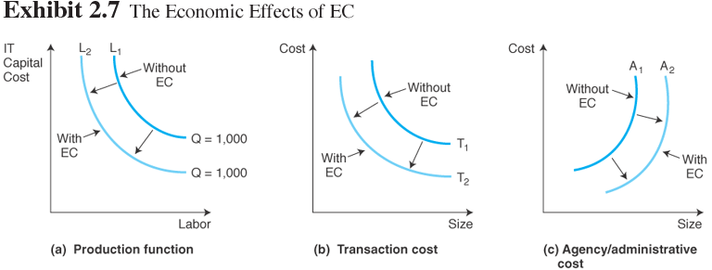
Economics of E-Marketplaces (cont.)

Slide 73
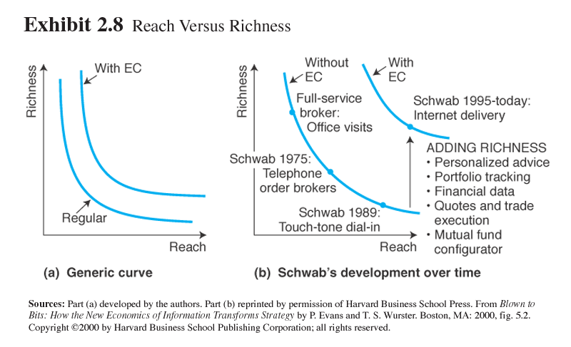
Economics of E-Marketplaces (cont.)

Slide 74
Competition in the Digital Economy
Internet ecosystem:
The business model of the Internet economy
Competitive factors
Lower search costs for buyers
Speedy comparisons
Differentiation and personalization
Differentiation: Providing a product or service that is unique
Personalization: The ability to tailor a product, service, or Web content to specific user preferences
Lower prices
Customer service

Slide 75
Competition in the Digital Economy (cont.)
Characteristics necessary for perfect competition are the following:
Many buyers and sellers must be able to enter the market at little or no entry cost
Large buyers or sellers are not able to individually influence the market
Products must be homogeneous (no product differentiation)
Buyers and sellers must have comprehensive information about the products and about the market participants’ demands, supplies, and conditions

Slide 76
Competition in the Digital Economy (cont.)
Porter’s competitive forces model:
The model that says that five major forces of competition determine industry structure and how economic value is divided among the industry players in the industry; analysis of these forces helps companies develop their competitive strategy

Slide 77
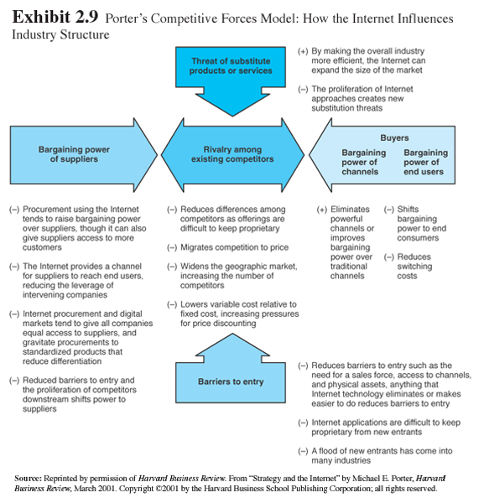
Exhibit 2.9 Porter’s Competitive Forces Model: How the Internet Influences Industry Structure

Slide 78
Impacts of E-Markets on Business Processes and Organizations
Improving direct marketing
Product promotion
New sales channel
Direct savings
Reduced cycle time
Improved customer service
Brand or corporate image
Customization
Advertising
Ordering systems
Market operations

Slide 79
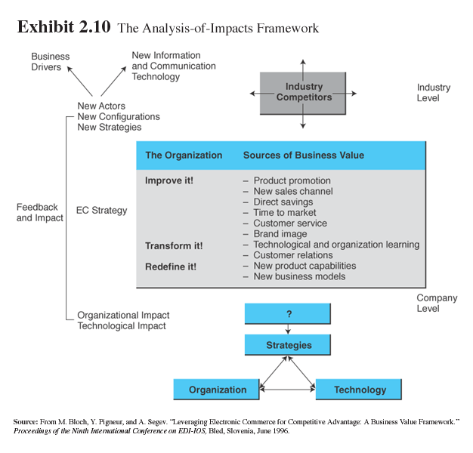
Exhibit 2.10: The Analysis-of-Impacts Framework

Slide 80
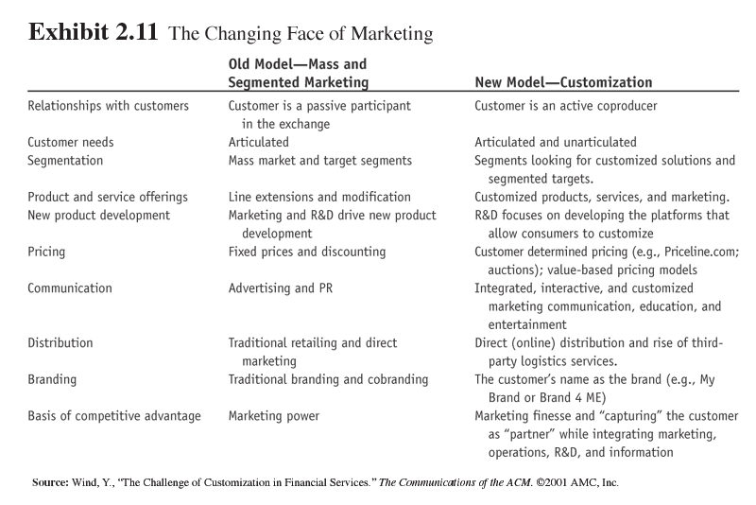
Exhibit 2.11: The Changing Face of Marketing

Slide 81
Transforming Organizations
Technology and organizational learning—the changing nature of work
Redefining organizations
New and improved product capabilities
New business models
Improving the supply chain
Impacts on manufacturing
Build-to-order: Production system in which manufacturing or assembly will start only after an order is received

Slide 82
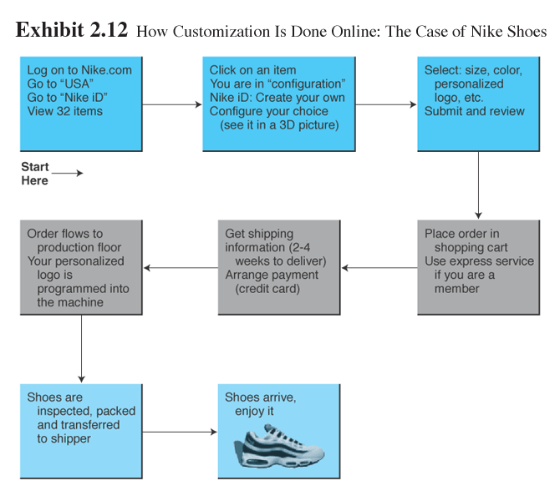
Exhibit 2.12: How Customization is Done Online (Nike Shoes)

Slide 83
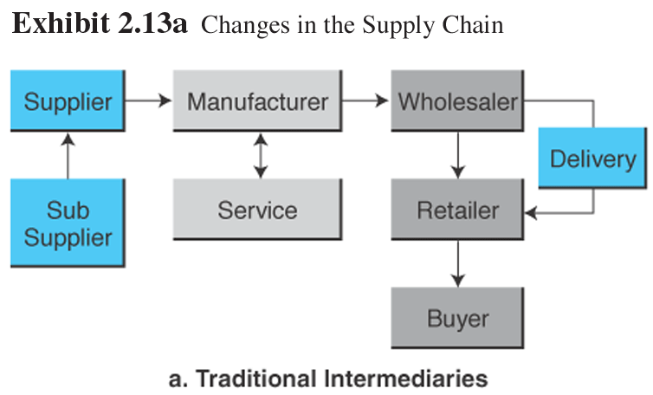
Exhibit 2.13: Changes in the Supply Chain

Slide 84
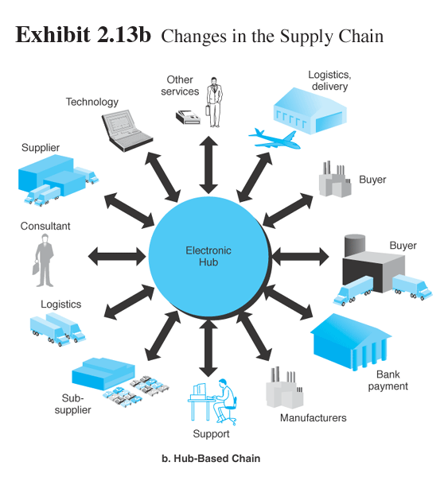
Exhibit 2.13: Changes in the Supply Chain (cont.)

Slide 85
Transforming Organizations (cont.)
Impacts on finance and accounting
Executing an electronic order triggers an action in what is called the back office that include:
buyers’ credit checks
product availability checks
order confirmation
changes in accounts payable, receivables, billing, and much more
These activities must be efficient, synchronized, and fast so that the electronic trade will not be slowed down

Slide 86
Transforming Organizations (cont.)
Impacts on human resource management
EC is changing how people are recruited evaluated, promoted, and developed
EC also is changing the way training and education are offered to employees
Companies cut training costs by 50 percent or more
New e-learning systems offer two-way video, on-the-fly interaction, and application sharing

Slide 87
Managerial Issues
How do we compete in the digital economy?
What about intermediaries?
What organizational changes will be needed?

Slide 88
Managerial Issues (cont.)
Should we auction?
Should we barter?
What m-commerce opportunities are available?

Slide 89
Summary
E-marketplaces and their components.
The major types of e-markets.
The role of intermediaries.
Electronic catalogs, search engines, and shopping carts.

Slide 90
Summary (cont.)
Types of auctions and their characteristics.
The benefits and limitations of auctions.
Bartering and negotiating.
The role of m-commerce.

Slide 91
Summary (cont.)
Liquidity, quality, and success factors in e-markets.
Economic impact of EC.
Competition in the digital economy.
The impact of e-markets on organizations.

Slide 92

Selesai

